Slide 1



Slide 2


Concept
Imagine a universe where Star Wars and Dungeons & Dragon fans merge role playing games with calculated combat scoring….in a user friendly app to quickly add & calculate damage level of combat during a campaign
Notes:
The basic concept of this simulator is reference to Dungeons and Dragons, (Commonly known as DnD) a very popular role-playing game, allowing the player to create their own character as they embark upon imaginary adventures within a fantasy setting. Since this simulator is virtual and has DnD elements, the principle key features to this game is allowing the player to understand the complexity of rolling for point damage against opponents.

Slide 3
Application Roles
The site has 3 roles:
Site admin (project team members)
Dungeon Master (DM) – campaign admin can view campaign player’s profiles & abilities, add campaigns, add players, & add damage points to player, options to publish
Regular Players

Slide 4
FEATURES
• Login or Registration Page
• Admin/DM dashboard to load scores & create campaigns
• Player dashboard to view player damage points, current & past campaigns

Slide 5
Programming Languages
Graphical User Interface – PHP/HTML/CSS
Database – MySQL
Game Play – C++

Slide 6


DATABASE STRUCTURE
User Groups
Users
Campaigns
Potential Add-Ons
Avatars for each type of player
Game play selection to incorporate scoring for other RP games
Weapons , Armor & Proficiency tables

Slide 7
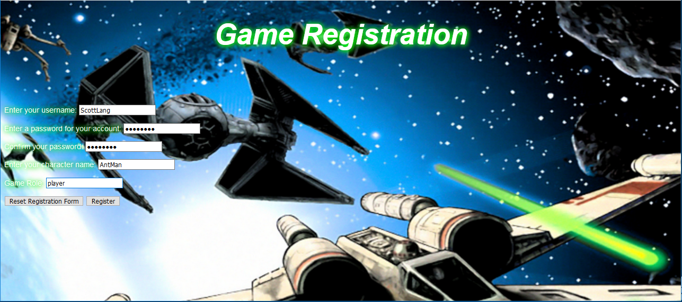
Register
Notes:
The basic original concept of registration of the game itself, which the imgary has its Star Wars theme, with original imagery from the Star Wars: Original Trilogy

Slide 8
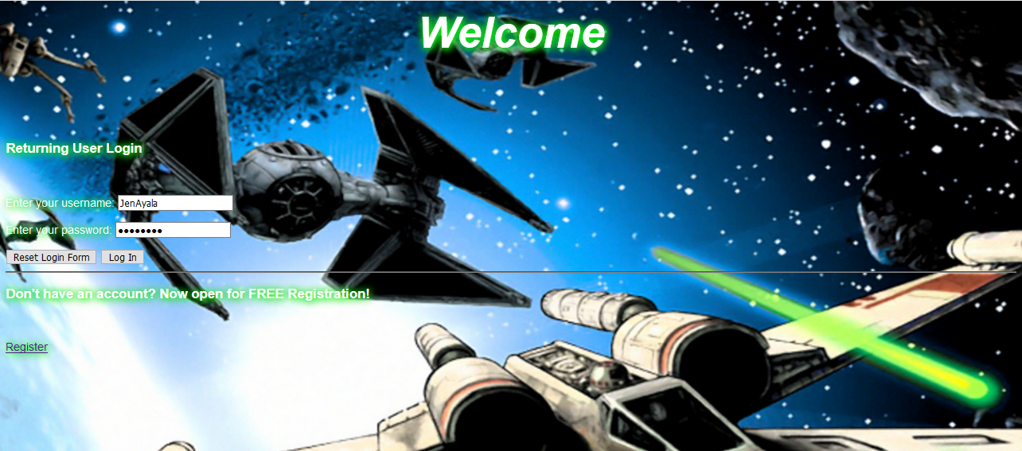
Login Screen

Slide 9
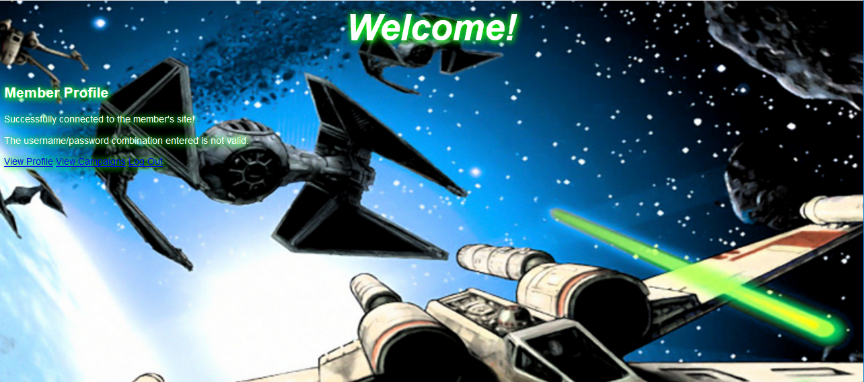
Player Membership Dashboard
No stats to view

Slide 10
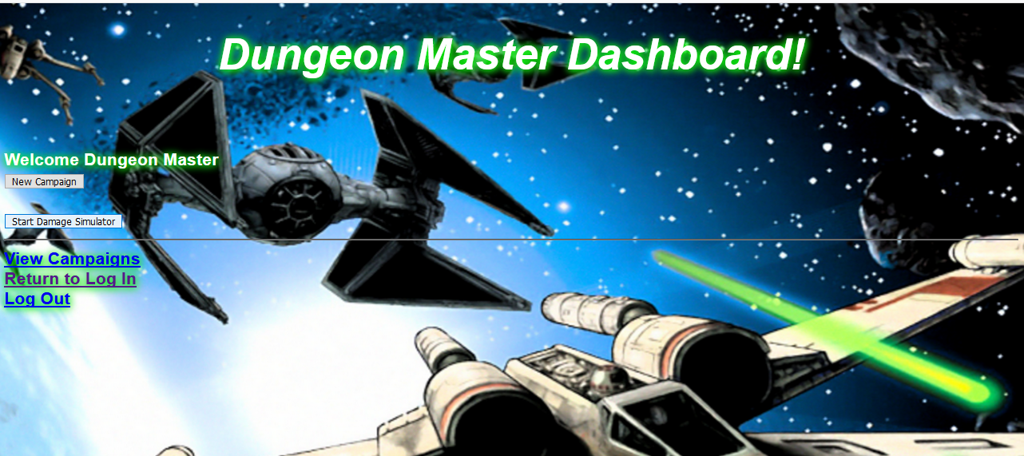
DM Membership Dashboard

Slide 11
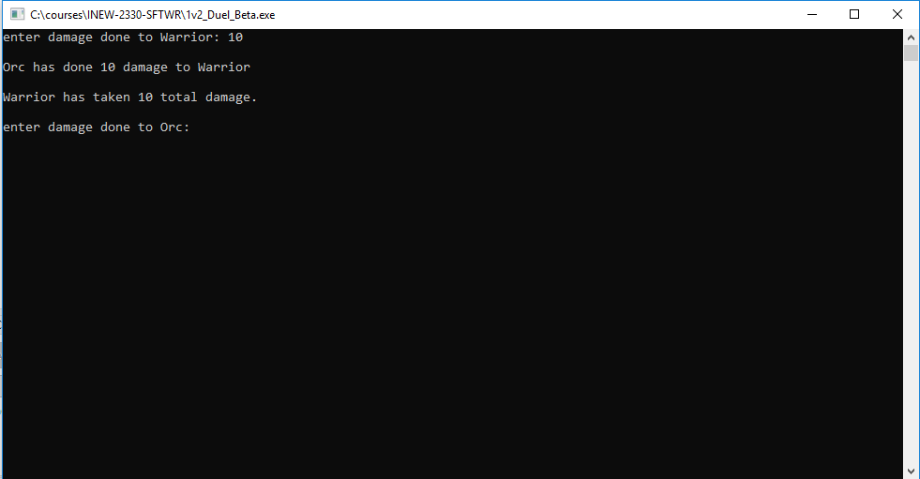
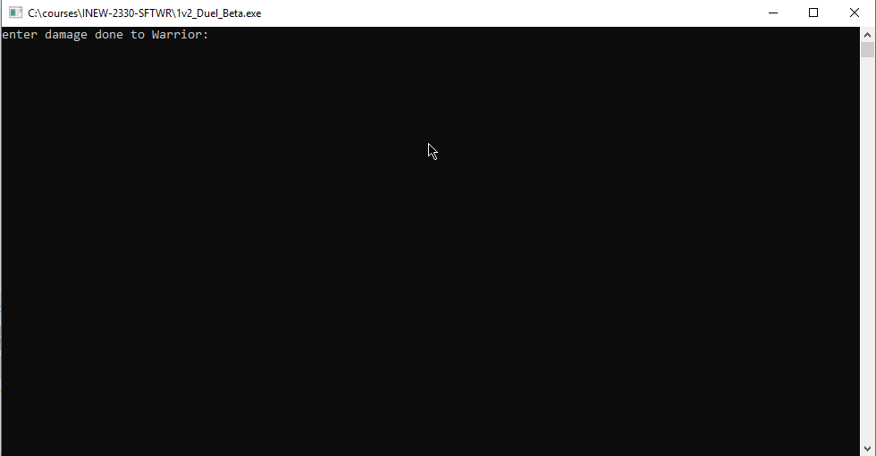
Entering Point Damage
Player 2
Notes:
To begin the simple gameplay process, the box is what the player will input point damage for a character (Example:”Warrior”); inputting the value (which represents rolling a die in actual DnD gaming.) that indicates the amount of point damage inflicted on that specific character; In return, the player will enter the value input to the other character (“Orc”) the amount of damage inflicted on “Orc”.

Slide 12
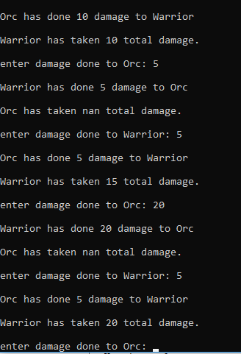
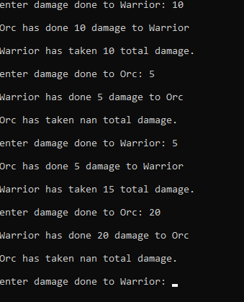
Game Play – Continued Play
Notes:
In continuation of the previous slide, the example on this slide shows the input of “5” into the amount of damage inflicted on “Orc”, which the result states that “Warrior has done 5 damage to Orc.” However “Orc” has taken the least amount of damage from “Warrior”.The process then repeats itself on the amount of value inputs that continue to calculate the amount of damage on both “Warrior” and “Orc”.

Slide 13
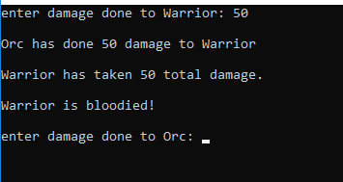
Game Play – Damage!
Notes:
In this slide, shows the total damage to the opposing player, the value input for “Orc” states “50” or higher, has done significant damage to “Warrior” which the outcome of this result states “Warrior is bloodied!” meaning that “Warrior” has taken a critical hit from their opponent.

Slide 14
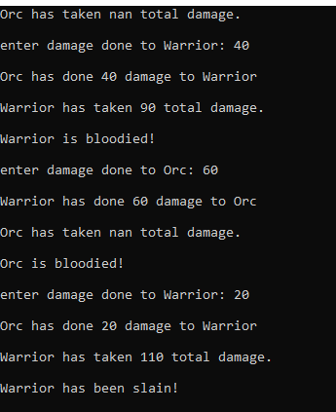
Game Play – We Have a Loser!
Notes:
This slide shows the climax of the continuation of the gameplay from the previous slides showing “Warrior has been slain!” meaning that the character has been defeated due to the overextension of the input of the value points that is beyond 50 to 100 range, resulting with “Warrior” taking a final blow of 110 total damage.

Slide 15
Upcoming/Potential Features
Ability to include additional players
Create a campaign
Edit profile
Integrated game simulator with GUI
Game play of multiple campaigns
Profile avatars
Drop down menu for game role
Statistics Dashboard

Slide 16
QUESTIONS ?

